Slide 1
Big Data Programming
Assignment 1 – R Programming
Alexander Croll
November 18, 2016

Slide 2
Agenda
Assignment 1b – Demonstration 1
Assignment 1b – Demonstration 2

Slide 3
Assignment 1b – Demonstration 1
Differences between Ward and single-linkage methods for hierarchical clustering
Ward:
Combining two points/clusters where the total distance from centroids of these two represents a minimum increase in total distance as compared to all other possible combinations at each step
Similar to complete-linkage, but looking at total deviation instead of centroid
Single-linkage:
Combining two points/clusters where two of their elements represent the minimum distance at each step
Produces long chains of elements, where elements at the ends of a cluster have a large distance between them
Nearest neighbour clustering

Slide 4
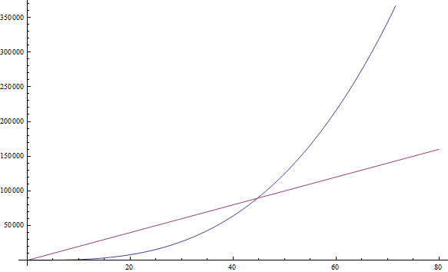
Assignment 1b – Demonstration 2
Computational Complexity – k-means vs. Hierarchical clustering
K-means:
O(n)
O( iterations * clusters * instances * dimensions )
Not the fasted, but for a clustering algorithm considerably fast
Builds only k clusters
Hierarchical:
Generally: O(n² * log(n))
Efficient cases (e.g. single-linkage): O(n²)
Not suited well for large amounts of data
Complete tree is built, then clusters can be cut from the tree

Slide 5
Assignment 1b – Demonstration 2
Within.cluster.ss and avg.silwidth metrics
Within.cluster.ss
Sum of squares of all values with the mean of the data is calculated
If not normalized, the sum of squares will increase with increasing data set
Different clustering methods can be compared by looking at the value of sum of squares: it represents the deviation from the mean, so if amount of data is the same, a lower sum of squares indicates that the values of the cluster are well classified and close to their respective means
Avg.silwidth:
Indication on how well a given value fits into its own cluster
Scale usually from -1 to 1
High values indicate that a value fits in well with own cluster

Slide 6
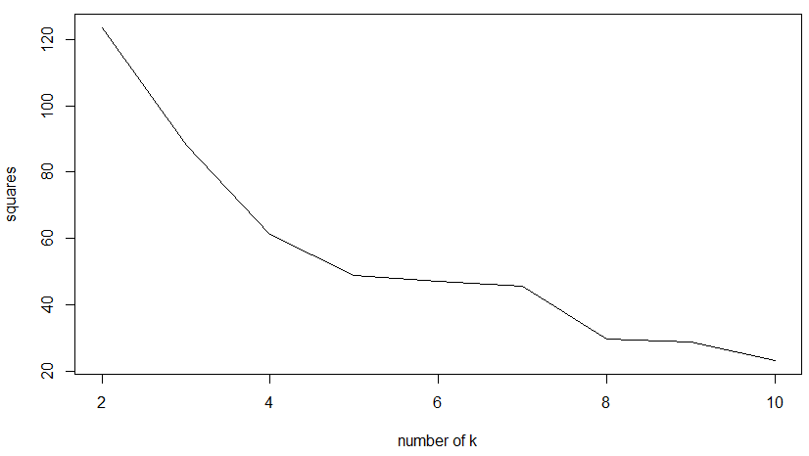
Assignment 1b – Demonstration 2
Best k based on WSS metric
According to the sum of squares depicted below, k = 10 for best results, meaning that the deviation from the mean of values within their clusters is at a minium

Slide 7
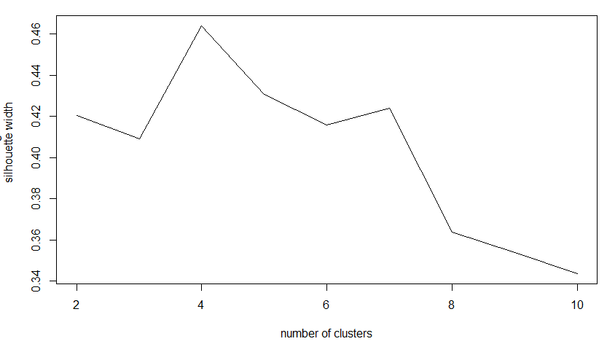
Assignment 1b – Demonstration 2
Best k based on silhouette metric
Silhouette metric is highest when using 4 clusters, indicating that the values fit well into their respective clusters

